Slide 1
5/24/17 HOW TO ACE THE GLOBAL REGENTS DBQ STYLE!
WE WILL EXAMINE A REGENTS EXAM
WE WILL STRATEGIZE HOW TO ACHIEVE MASTERY ON SAID EXAM
(85 OR HIGHER)
WHO WILL GET A 100??

Slide 2
Basic Information
The regents exam in Global History is June 15 at 8:00 AM
Bring with you a student ID, pens, and pencils
Do NOT bring electronic devices

Slide 3
Structure of the Test
The regents exam tests material from 9th and 10th grade
Part I: 50 multiple-choice questions
Part II: thematic essay question
Part III: documents-based essay question

Slide 4
Study Strategies
practice multiple-choice questions
refresh your memory on key historical topics
review essay outlines
attend review sessions

Slide 5
5/24/17 HOW TO ACE THE GLOBAL REGENTS DBQ STYLE!
GROUPS PERIOD 6
1: CRYSTAL, JAMES, ALEX, JON
2: BRITTNEY, ZACH S, ARACELY, DESIREE
3 ANTHONY, ALEXA, BRIANNA, ELI
4: SHANNEN, TAYLOR, SARAH,KATIE
5ERIN, EVE, ETHAN, ZACH N

Slide 6
5/24/17 HOW TO ACE THE GLOBAL REGENTS DBQ STYLE!
GROUPS, PERIOD 8
1:NOAH, AMANDA, BIANCA, AURORA, MARLEEN
2: ETHAN, REBECCA, ROBERT, ODALYS
3: LINDSEY, KYLAN, KEQING, RYAN
4: ALEX, MANNY, ARIANA, JESSICA

Slide 7
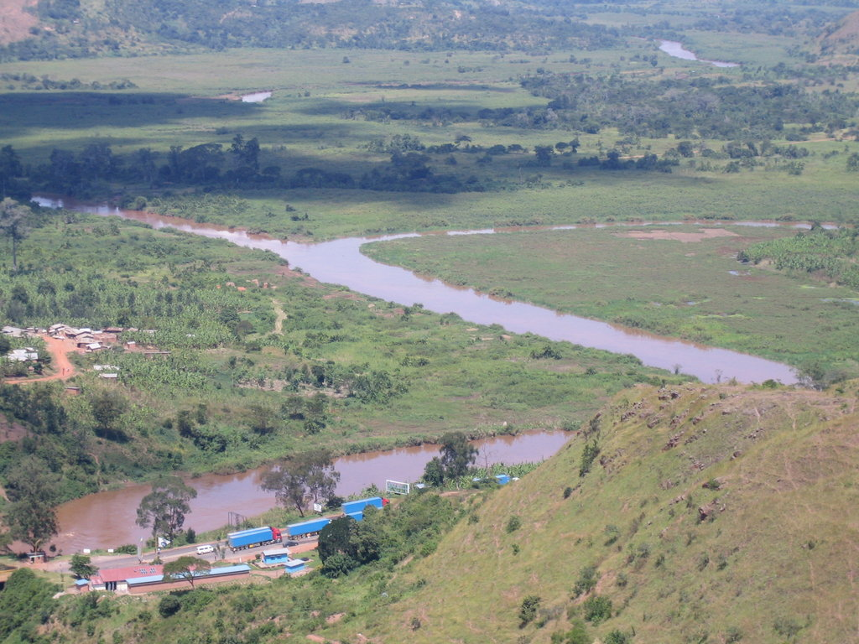

Slide 8
Geography
river valleys
mountain ranges
deserts
climate
natural resources

Slide 9
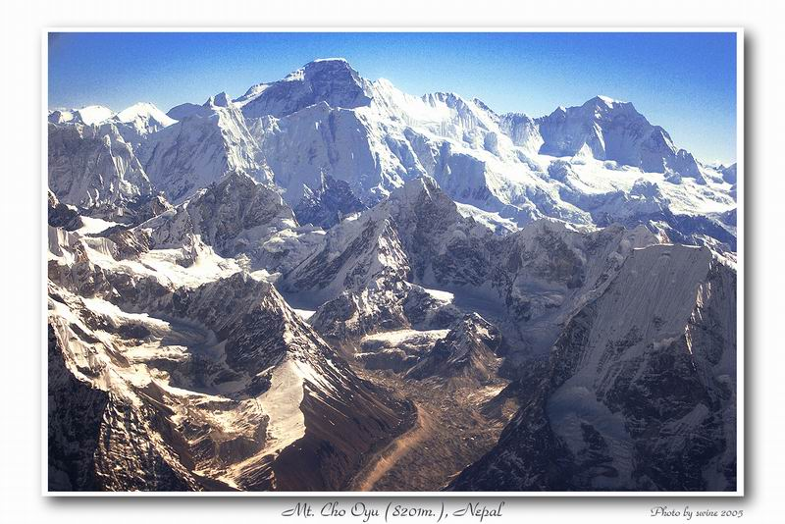

Slide 11
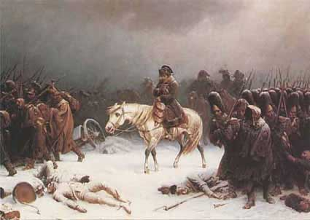

Slide 12
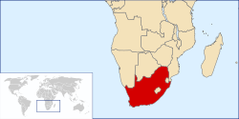

Slide 13
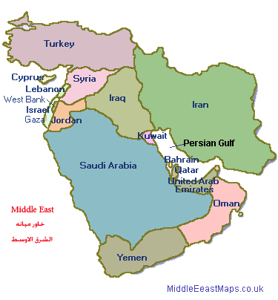
Oil

Slide 14
Religions
Animism
Judaism
Christianity
Islam
Buddhism
Hinduism
Confucianism
Protestantism

Slide 15
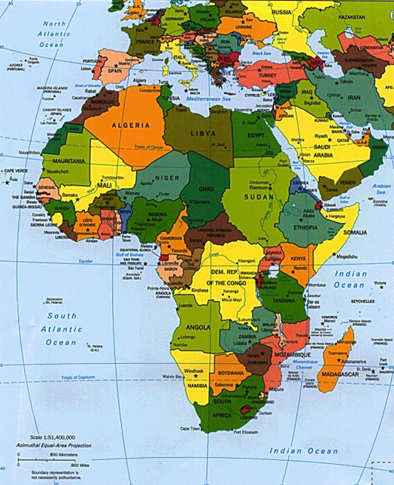

Slide 16
Judaism, Christianity, Islam
Middle East
monotheistic
behavior codes

Slide 17
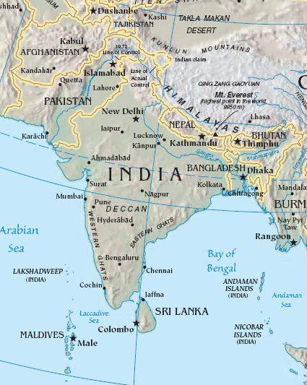

Slide 18
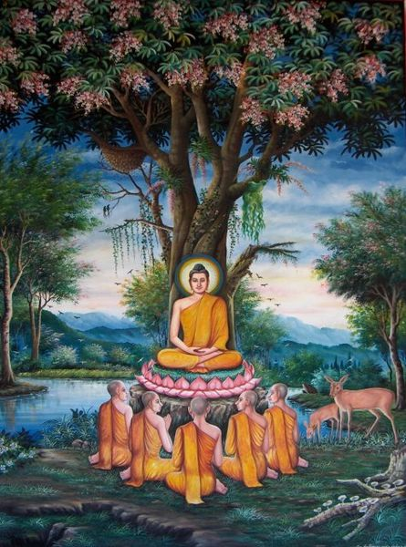

Slide 19
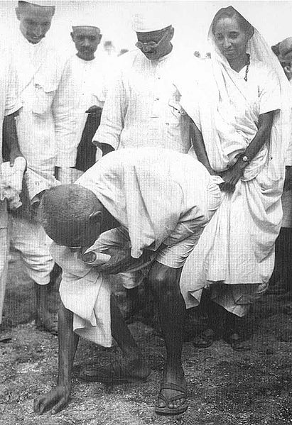

Slide 20
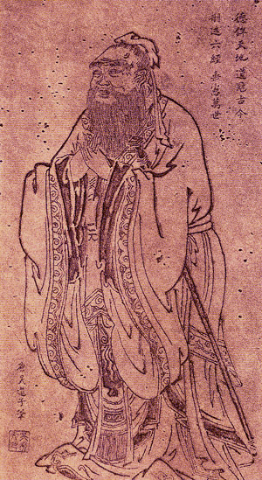

Slide 21
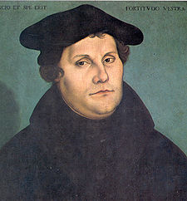

Slide 22
Golden Ages
Ancient Egypt
Ancient Greece
Ancient Rome
India under the Gupta Dynasty
The Islamic World
Europe during the Renaissance

Slide 23
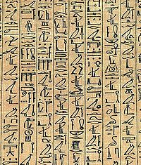
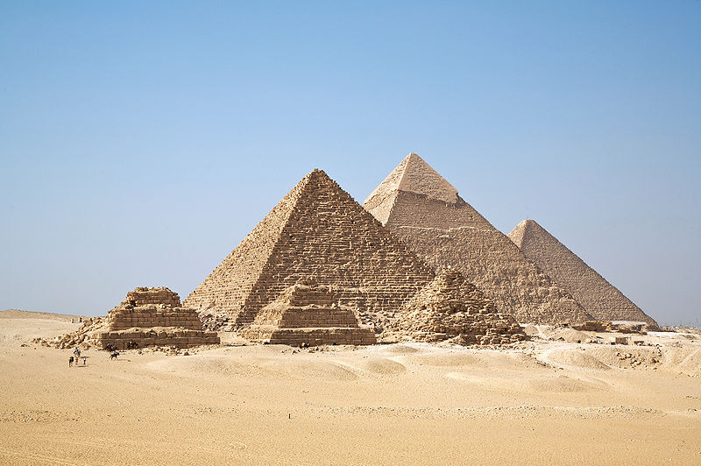

Slide 24
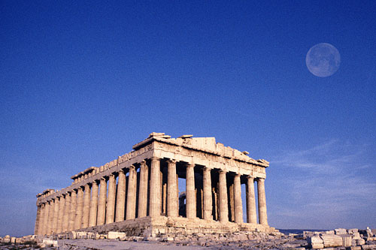

Slide 25
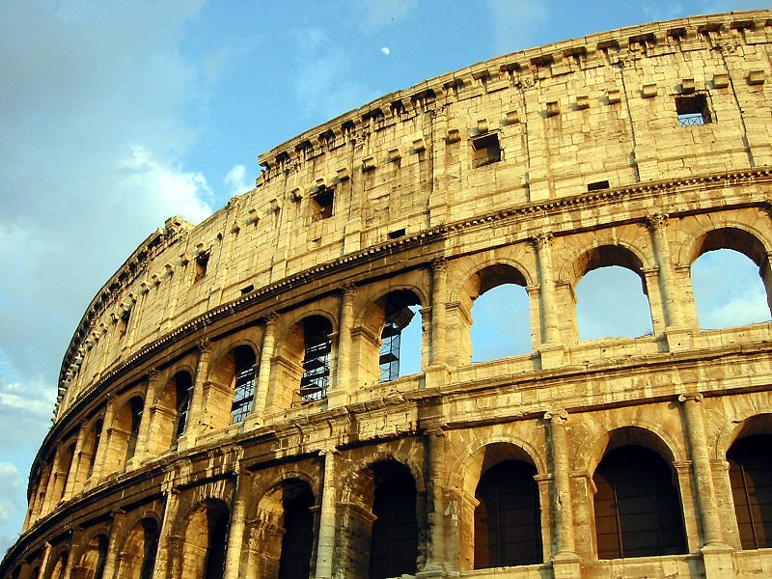

Slide 26
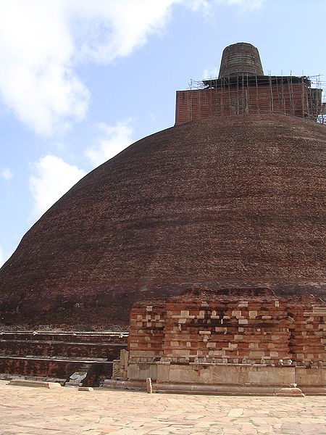

Slide 27
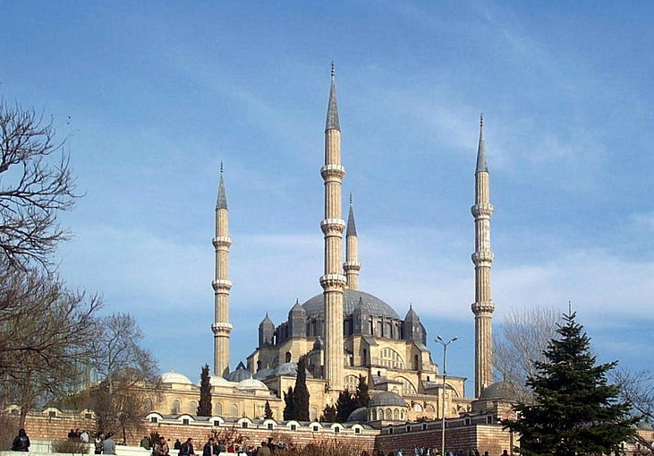

Slide 28
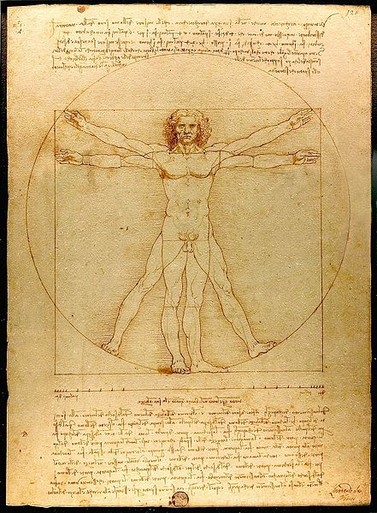
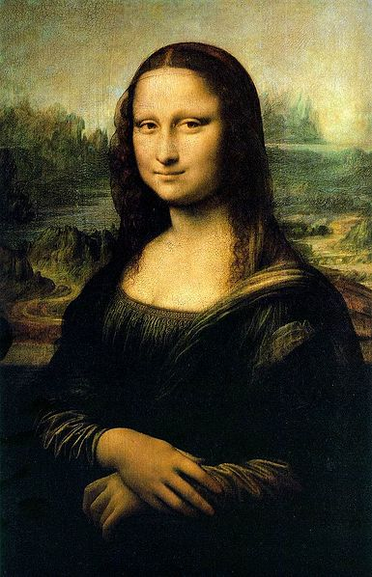
Leonardo da Vinci

Slide 29
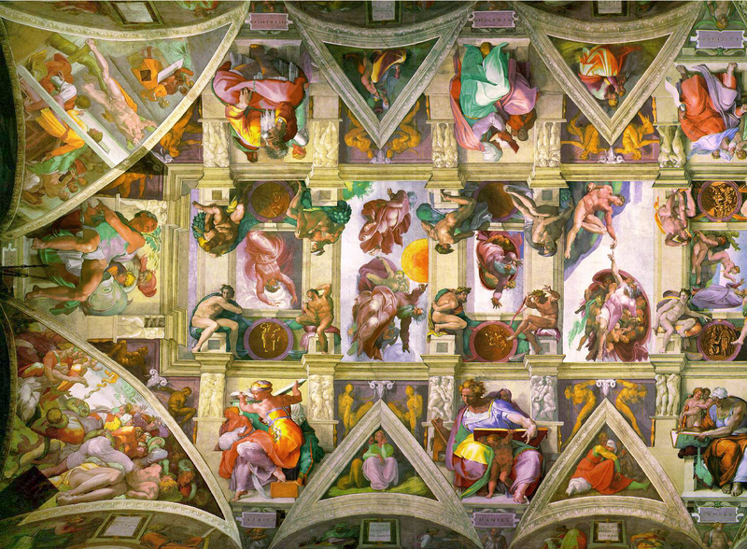

Slide 30
Turning Points

Slide 31
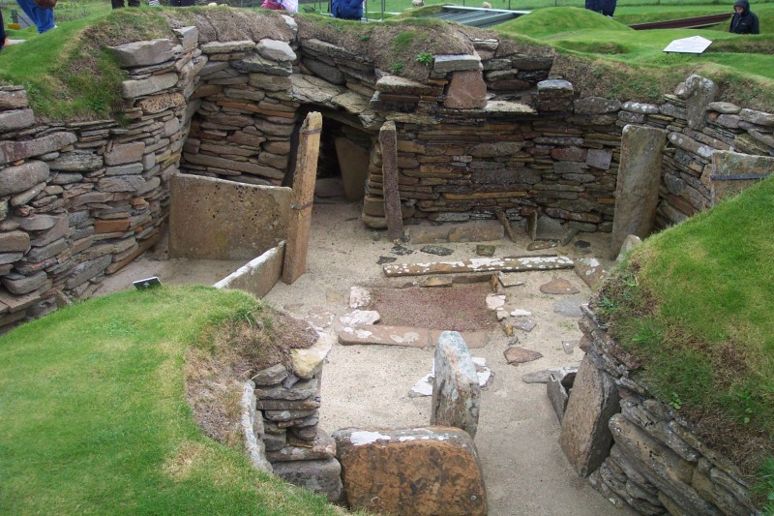

Slide 32
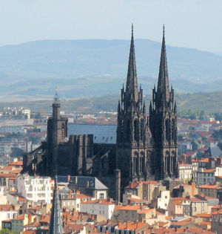

Slide 33
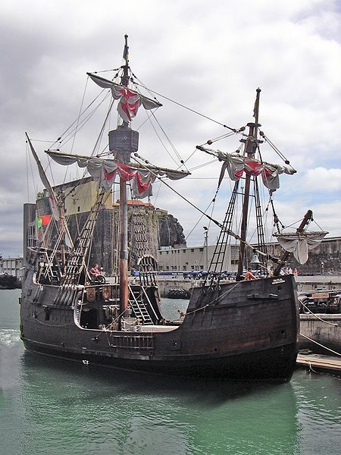

Slide 34
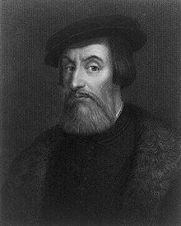

Slide 35
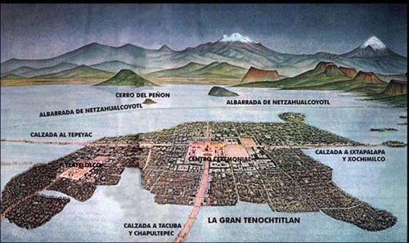

Slide 36
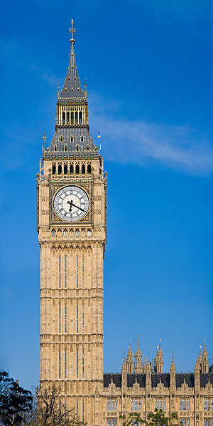

Slide 37
The French Revolution
The Three Estates of France in 1789
1st Estate (clergy)
2nd Estate (nobles)
3rd Estate (bourgeoisie, city workers, peasants)

Slide 38
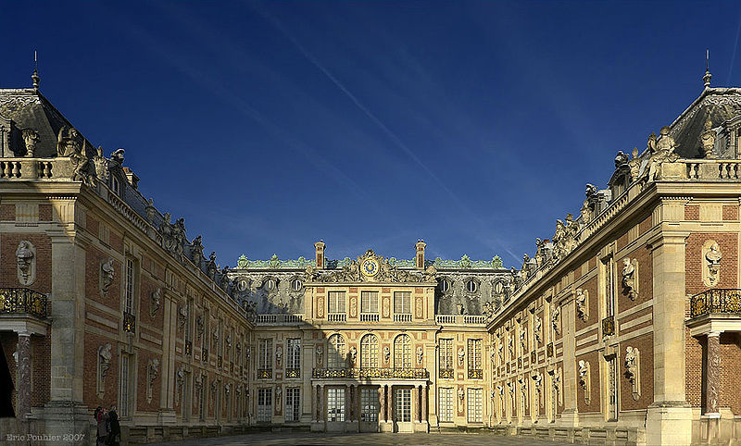

Slide 39
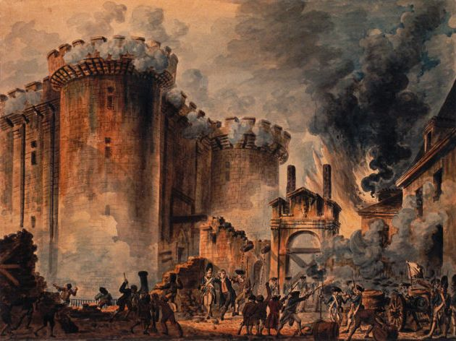

Slide 40
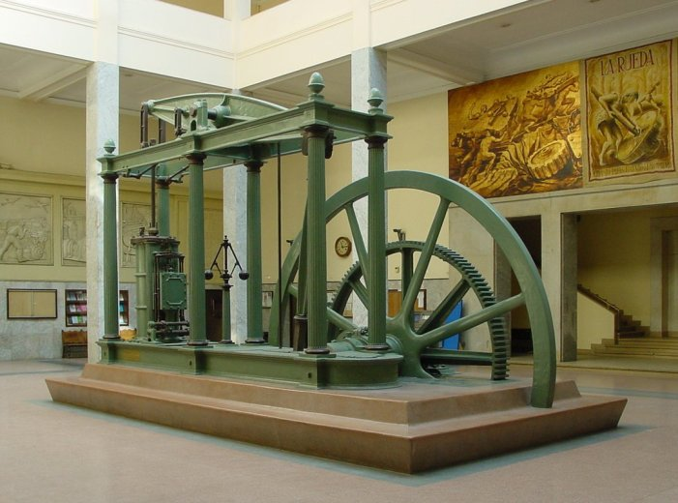

Slide 41
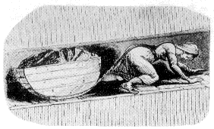
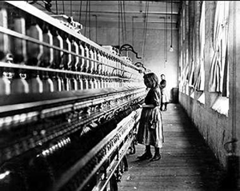
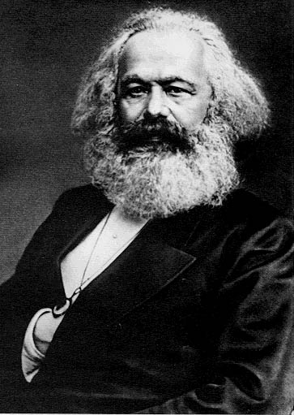

Slide 42
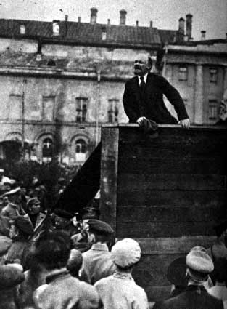

Slide 43
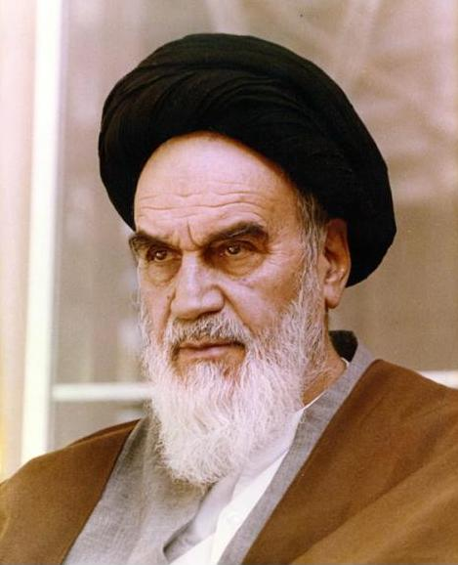

Slide 44
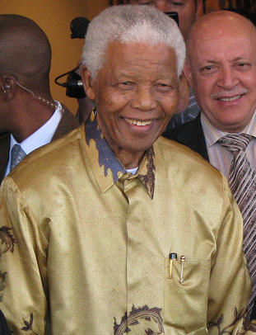

Slide 45
Political Systems
democracy
feudalism
absolute monarchy
totalitarianism

Slide 46
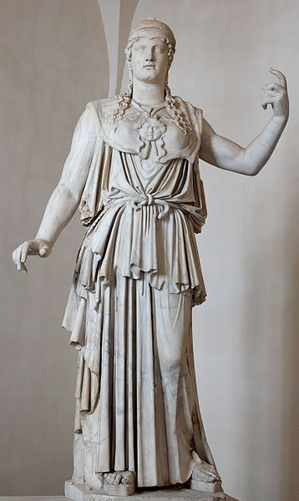

Slide 47
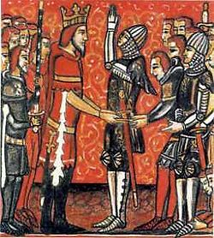

Slide 48
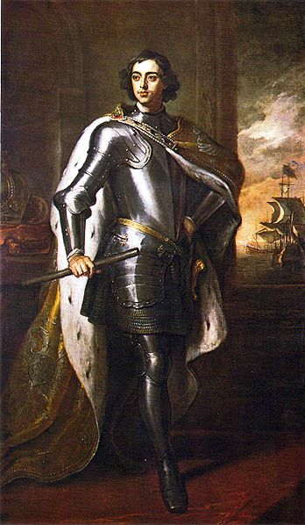
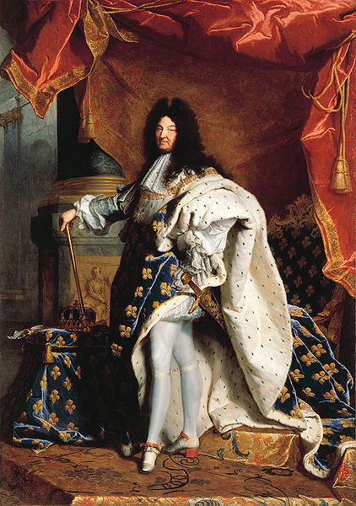

Slide 49
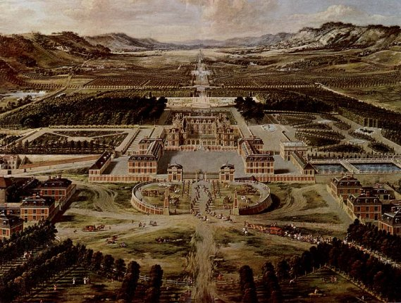

Slide 50
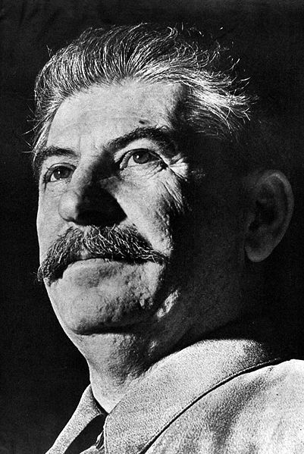
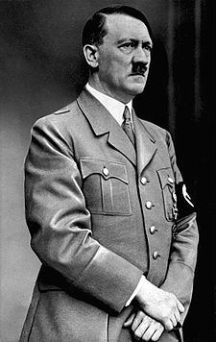
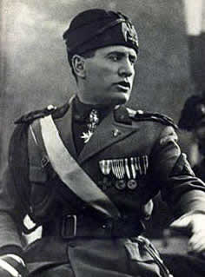
Totalitarianism
dictator
secret police
censorship

Slide 51
Economic Systems
traditional economies
manorialism
mercantilism
capitalism
communism

Slide 52
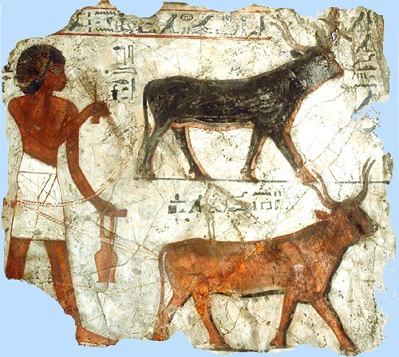

Slide 53
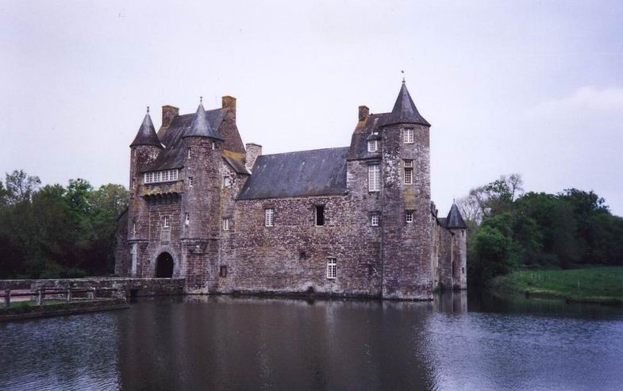

Slide 54
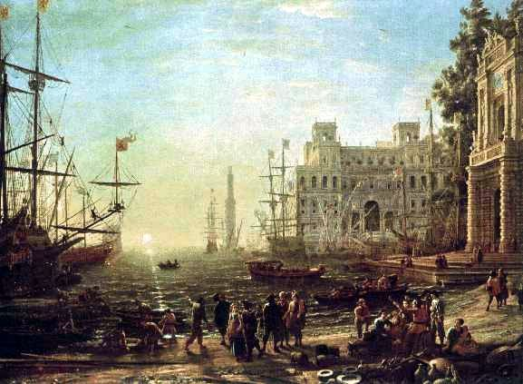

Slide 55
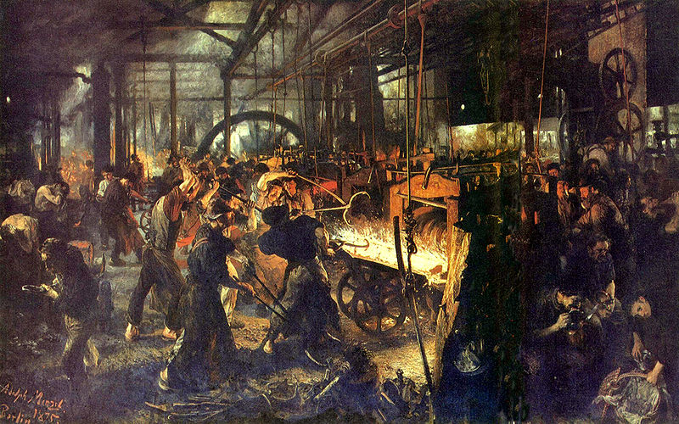

Slide 57
Human Rights Violations

Slide 58
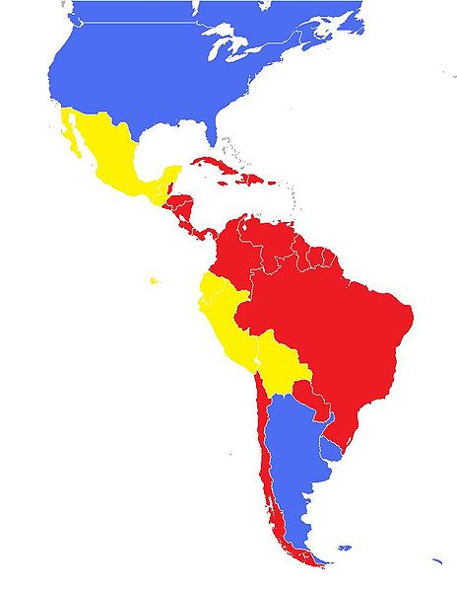

Slide 59
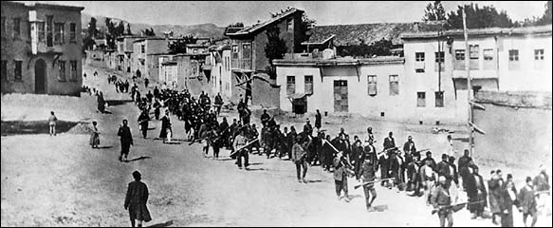

Slide 60
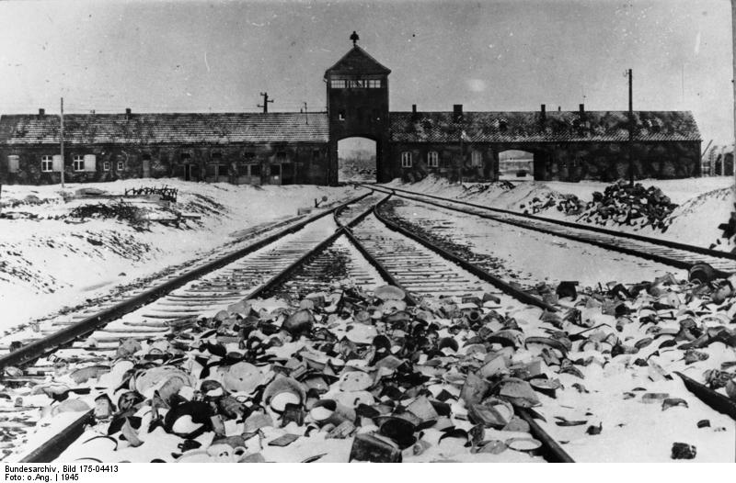

Slide 66
Threats to Our World
disease
overpopulation
desertification
deforestation
pollution
nuclear proliferation

Slide 73
Test-taking Strategies

Slide 74
Process of Elimination (POE)
Eliminate choices you know are wrong

Slide 75
Which document is an example of a primary source?
a novel of the Age of Discovery
a diary of a Holocaust survivor
a textbook on Latin American history
an encyclopedia article on Songhai culture

Slide 76
Word Association
Identify key words in the question and match those words with words in the choices

Slide 77
Which statement best describes an aspect of a command economy?
Profit motivates individuals to set up private businesses.
Tradition, religion, and customs heavily influence economic decisions.
Supply and demand regulate the economy
Government directs and controls the means of production.

Slide 78
“Finally, let us put together the things so great and so august (exalted) which we have said about royal authority. Behold an immense people united in a single person; behold this holy power, paternal and absolute; behold the secret cause which governs the whole body of the state, contained in a single head: you see the image of God in the king, and you have the idea of royal majesty. God is holiness itself, and power itself. In these things lies the majesty of God. In the image of these things lies the majesty of the prince…”
-Bishop Jacques-Benigne Bousset, 1679

Slide 79
This passage suggests that the authority to rule in 17th century France was based on
popular sovereignty
parliamentary consent
feudal obligation
divine right

Slide 80
Positive/Negative
Decide if the question requires a positive or negative answer and look for choices that are positive or negative

Slide 81
The Golden Age of Muslim culture was best known for its
Attempts to colonize North America
Frequent conflicts between Christians and Jews
Advances in mathematics, science, and medicine
Policies to reduce trade between the Middle East and China

Slide 82
Thematic Essay
read the historical context and the task carefully so you know exactly what you need to do
read the suggested topics and choose the topics you know best
write a brief outline

Slide 83
Thematic Essay Question
Theme: Change [Political Events]
Twentieth-century political events have had positive and negative effects on global history.

Slide 84
Task:
Identify two 20th-century political events and for each
-Discuss the historical circumstances surrounding the event
-Evaluate the extent to which this event has had a positive or negative effect on global history

Slide 85
You may use any major political event from your study of global history. Some suggestions you may wish to consider include Lenin’s establishment of a Communist government in Russia, rise of totalitarian governments in Europe, Ho Chi Minh’s unification of Vietnam against imperialism, increasing support for Islamic fundamentalism in the Middle East, Mao Zedong’s Cultural Revolution in China, the dismantling of the Berlin Wall, development of nuclear weapons in India and Pakistan, and Nelson Mandela’s opposition to apartheid in South Africa.
You are not limited to these suggestions.
Do not use the United States in your answer, although discussion of positive and negative effects may involve the role of the United States.

Slide 87
Documents-Based Essay Question
read the historical context and the task carefully
read the documents and answer the scaffolding questions
write a short outline

