Slide 1
As you study this power point, make sure you know the following:
  The qanat system and why it spread
  The types of goods traded in the Indian Ocean basin
  The importance of the monsoons, esp. their regularity, in the Indian Ocean trading network
  How China with its capital at Chang’an and Rome anchored the 2 ends of the silk roads. Romans wanted silk, a luxury item from China, and the Chinese wanted grapevines and other luxury items from the Mediterranean
  Phoenicia was an important maritime civilization that established colonies in the Med. Athens and Rome did also. In fact, this is what brought Rome and Carthage (a Phoenician colony) into conflict. The Med. Wasn’t big enough for both.
  The new types of technologies that facilitated the long-distance trade.
    What was different about the lateen sail?
  The impact disease had on the fall of the Roman empire

Slide 2
Long Distance Trade: The Silk, Sand, and Sea Roads

Slide 3
Influences of Long-distance Trade
Brought wealth and access to foreign products and enabled people to concentrate their efforts on economic activities best suited to their regions
Facilitated the spread of religious traditions beyond their original homelands
Facilitated the transmission of disease

Slide 4
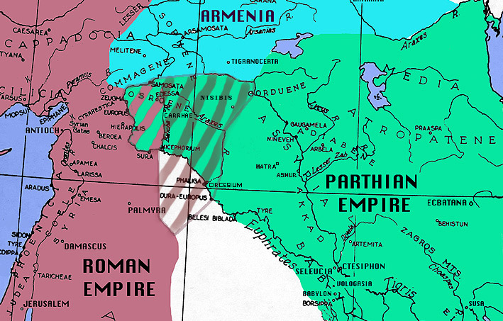
Contributions of Classical Empires
Classical empires such as the Han, Kushan, Parthian, and Roman brought order and stability to large territories
  They undertook massive construction projects to improve transportation infrastructure
  The expanding size of the empires brought them within close proximity to or even bordering on each other
Only small buffer states separated the Roman and Parthian empires

Slide 5
Silk Roads
As classical empires reduced the costs of long-distance trade, merchants began establishing an extensive network of trade routes that linked much of Eurasia and northern Africa
Collectively, these routes are known as the “Silk Roads” because high-quality silk from China was one of the principal commodities exchanged over the roads

Slide 6
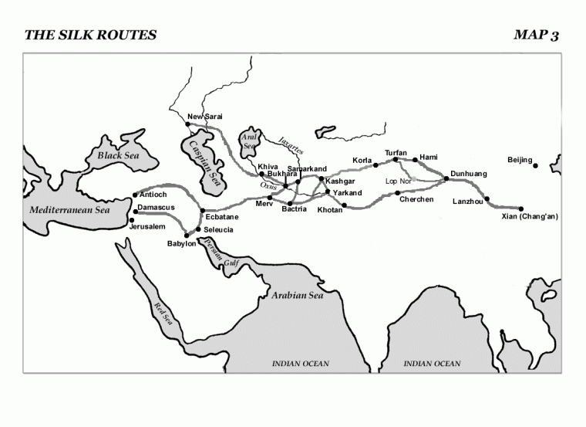

Slide 7
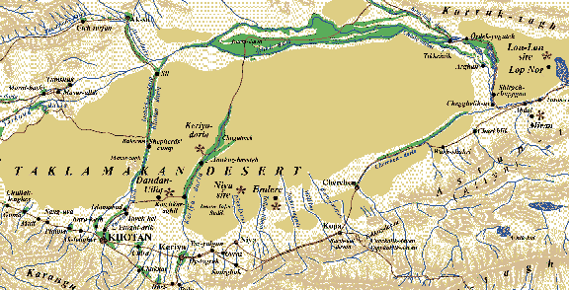
Route of the Overland Silk Road
Linked China and the Roman Empire
  The two extreme ends of Eurasia
Started in the Han capital of Chang’an and went west to the Taklamakan Desert
  There the road split into two main branches that skirted the desert to the north and south

Slide 8
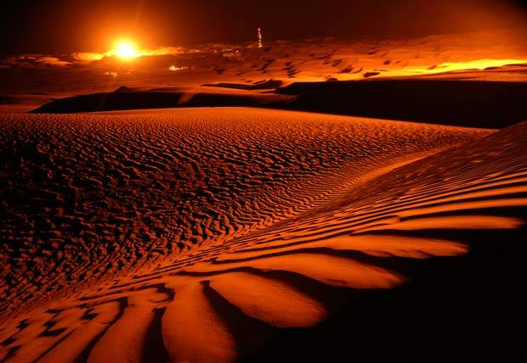
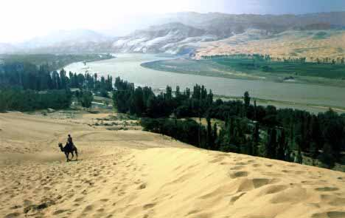
Taklamakan Desert:
“The Desert of Death”
The Silk Roads avoided the Taklamakan Desert and passed through the oasis towns on its outskirts

Slide 9
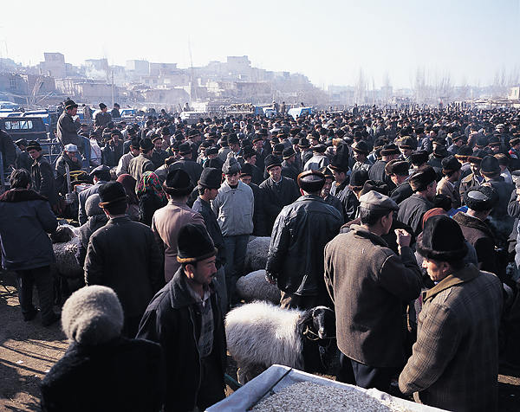
Route of the Overland Silk Road
The branches reunited at Kashgar (now Kashi in the western corner of China) and continued west to Bactria
  There one branch forked off to Taxila and northern India while the main branch continued across northern Iran
There is still a bustling Sunday market at Kashgar

Slide 10

Route of the Overland Silk Road
In northern Iran, the route joined with roads to ports on the Caspian Sea and the Persian Gulf and proceeded to Palmyra (modern Syria)
  There it met roads coming from Arabia and ports on the Red Sea

Slide 11
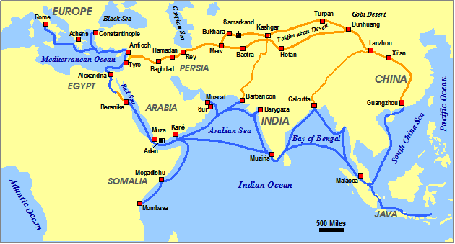
Silk Road
It continued west and terminated at the Mediterranean ports of Antioch (in modern Turkey) and Tyre (in modern Lebanon)

Slide 12
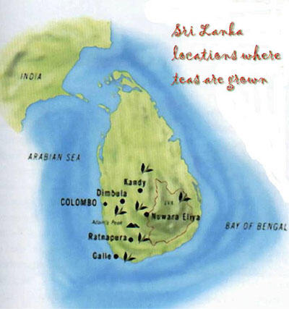
Sea Lanes
The Silk Roads also provided access at ports like Guangzhou in southern China that led to maritime routes to India and Ceylon (modern-day Sri Lanka)

Slide 13
Organization of Long-distance Trade
Individual merchants usually did not travel from one end of Eurasia to the other
Instead they handled long-distance trade in stages
  Chinese, Parthians, Persians, Indians, Romans, and others would dominate the caravan or maritime trade routes within their empire or territory of influence
GEOGRAPHY determined what was exchanged, where it was exchanged, and by whom it was exchanged

Slide 14
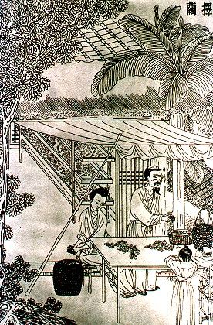
Silk Road Trade to the West
Silk and spices traveled west from southeast Asia, China, and India
  China was the only country in classical times where cultivators and weavers had developed techniques for producing high-quality silk fabrics
  Spices served not just to season food but also as drugs, anesthetics, aphrodisiacs, perfumes, aromatics, and magical potions
Chinese silk making

Slide 15
Silk Road Trade to the East
Central Asia produced large, strong horses and jade that was highly prized by Chinese stone carvers
The Roman empire traded glassware, jewelry, works of art, decorative items, perfumes, bronze goods, wool and linen textiles, pottery, iron tools, olive oil, wine, and gold and silver bullion
  Mediterranean merchants and manufacturers often imported raw materials such as uncut gemstones which they exported as finished products in the form of expensive jewelry and decorative items

Slide 16
Products that Contributed to Silk Road Commerce
China: silk bamboo, mirrors, gunpowder, paper, rhubarb, ginger, lacquerware, chrysanthemums
Siberia and Central Asia: furs, amber, livestock, horses, falcons, hides, copper vessels, tents, saddles, slaves
India: cotton textiles, herbal medicine, precious stones, spices
Middle East: dates, nuts, almonds, dried fruit, dyes, lapis lazuli (ore to make blue dye), swords
Mediterranean: gold coins, glassware, glazes, grapevines, jewelry, artworks, perfume, wool and linen textiles, olive oil

Slide 17
The Sea Roads

Slide 18
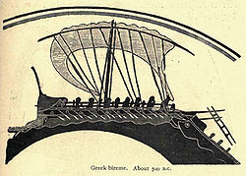
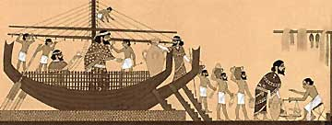
The Mediterranean
Phoenicians
  Major maritime trade state from 1550 to 300 BCE
  Established trade colonies throughout Mediterranean and Black seas
  First to use polar star for navigation
  Acted as “trucking company” for major states
Phoenicians trading with Egyptians
Greek bireme circa 500BC

Slide 19
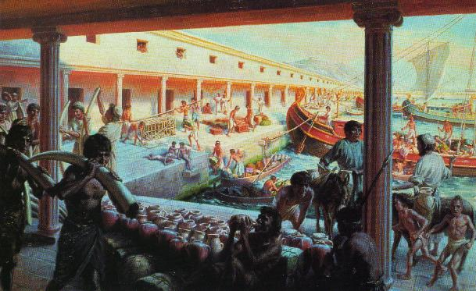
Carthage
Carthage
  Established as a colony by Phoenicians
  Maritime trade power – dominated the western Mediterranean
  Economic policies focused on protection of sea lanes and securing natural resources
  Some evidence of trade w/sub-Saharan Africa and British Isles
City of Carthage

Slide 20
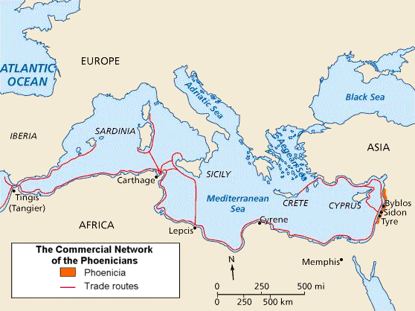

Slide 21
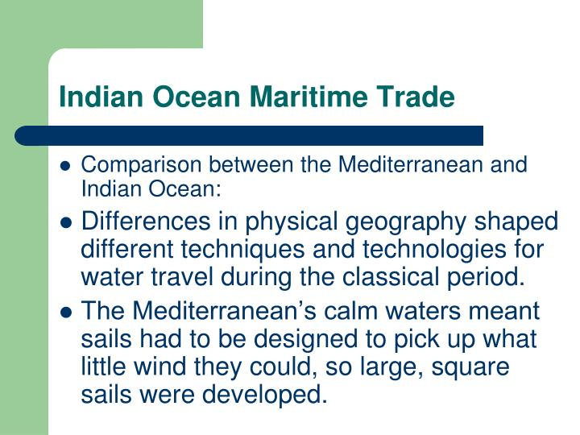

Slide 22
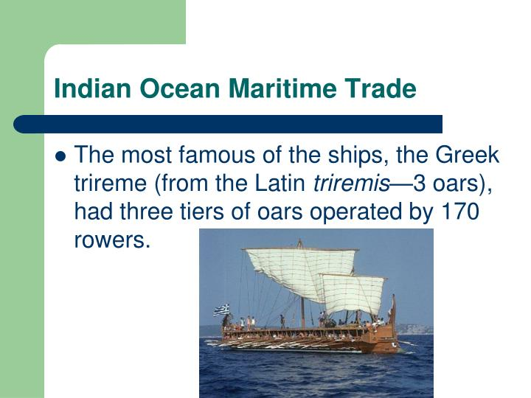

Slide 23
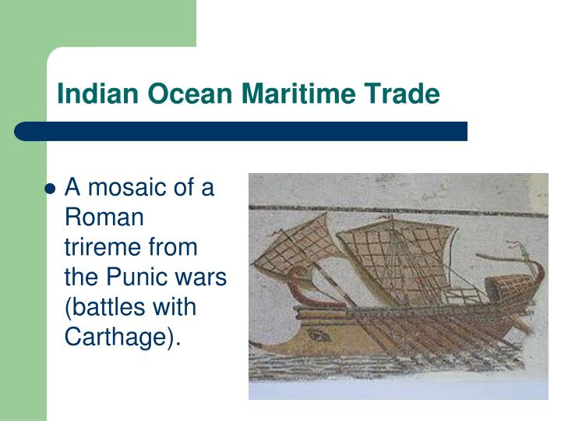

Slide 24
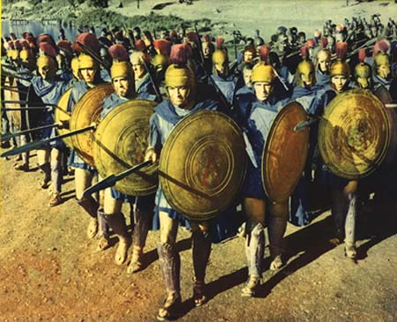
Greek City-States
Greek City-States
  Colonies established to
    Act as bases for trade
    Relieve population pressures
    Provide food for mother city-state
  Sparta
    To emphasize equality – Spartans banned precious metals and coins
    Spartans forbidden to engage in commerce
Spartan hoplites

Slide 25
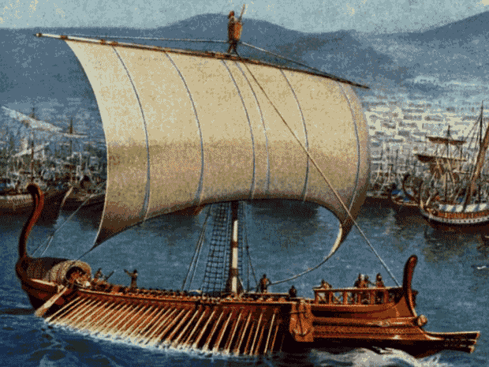
Athenian Trade
Athens
  Size of Athenian navy allowed Athens to project power to enhance commercial interests
  Transformation of Delian League into trade association
  Commercial estates = wine and oil exports
An Athenian Trireme

Slide 26
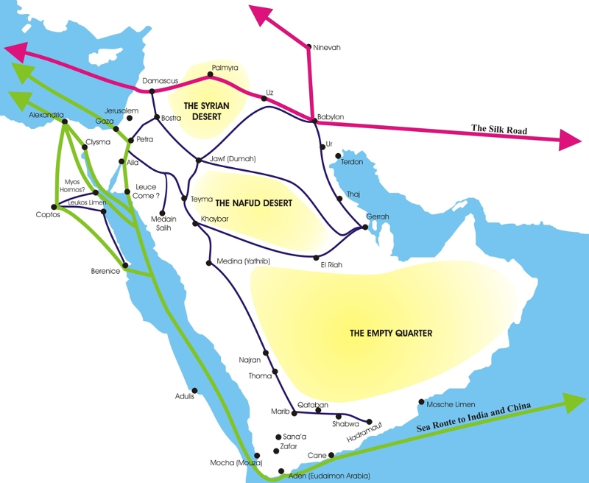
Alexandria
Hellenistic Civilization
  Greek culture widespread – based on empire of Alexander the Great
  Alexandria – nexus of Mediterranean and Indian Ocean trade (via Red Sea)
Hellenic Trade Routes

Slide 27
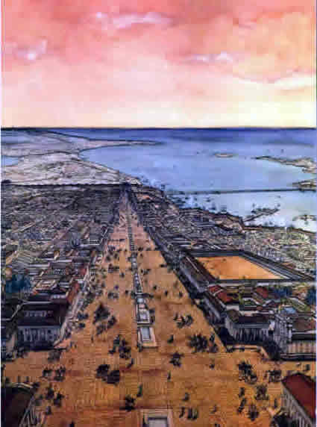
Alexandria
Planned city built by Alexander the Great
Dominated by its huge lighthouse
Significant port city
  Romans took wheat back to Rome from Alexandria
  Glass, papyrus, textiles, ointments, gems, and spices were also traded through this port
Also famous for its university and library—intellectual center of learning

Slide 28
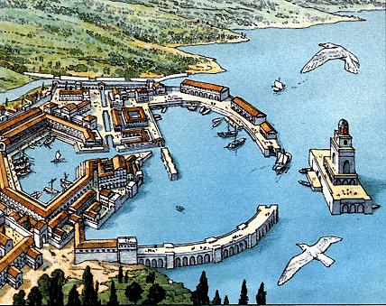
Rome
Rome
  Central location – positive impact on trade
  Territorial expansion brought in revenue and surplus goods from new provinces
  Roman provincial towns drew in artisans and merchants from all over
Busy Roman port

Slide 29
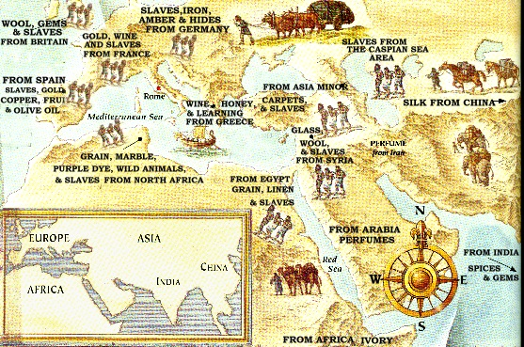

Slide 30
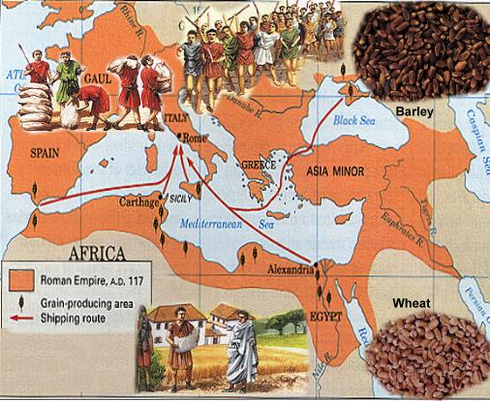
Roman Grain Trade

Slide 31
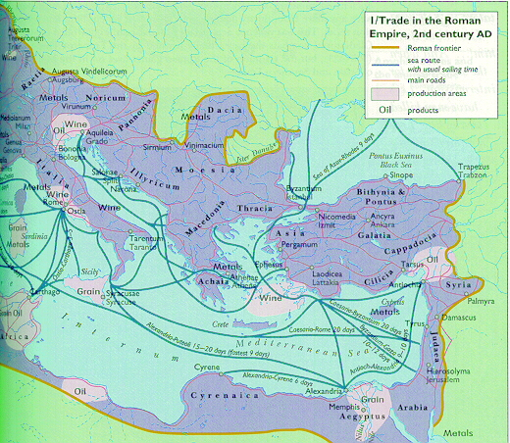
Roman Mediterranean Trade

Slide 32
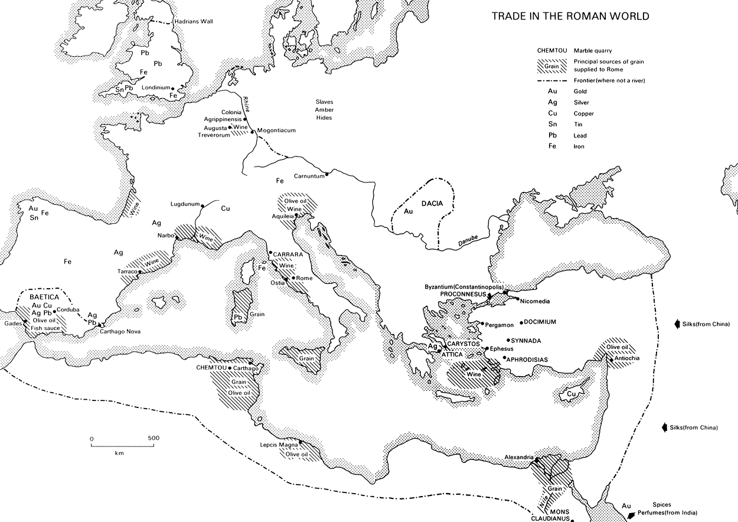

Slide 33
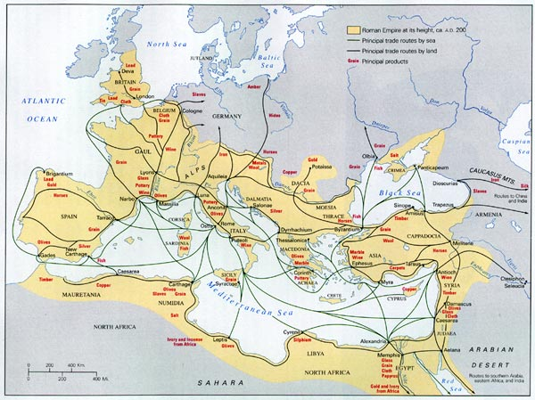

Slide 34
Indian Ocean Trade
Probably most important trade network
Monsoon changes were crucial:
  Nov-Feb blew to SW
  April-Sept blew to NE
  Key was regularity
Sea transport is cheaper
So more bulk goods: textiles, pepper, timber, rice, sugar, wheat
Trade was between towns and cities, not states

Slide 35
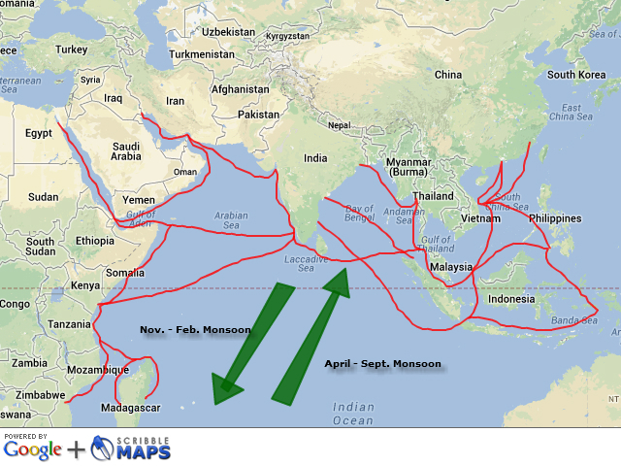

Slide 36
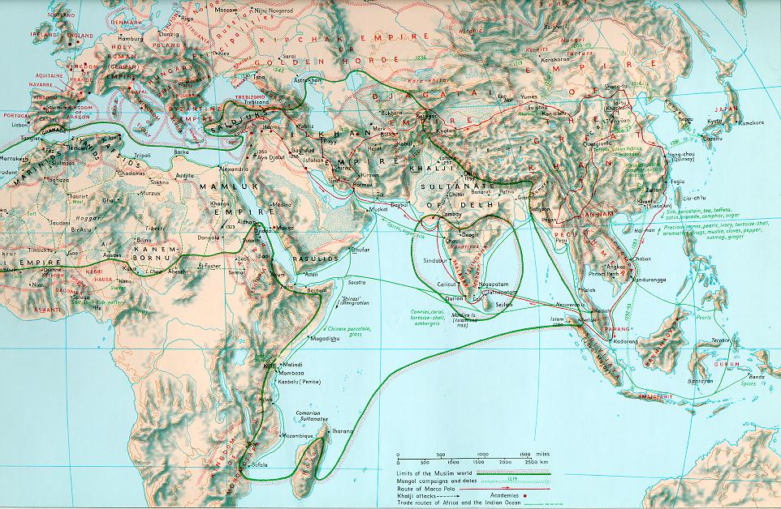
Indian Ocean Trade
“Zone of interaction”
First ocean to be crossed
“Sailor's ocean”
  Warm water
  Fairly placid waters
Lateen Sail allowed sailors to sail across the Indian ocean, could sail into wind

Slide 37
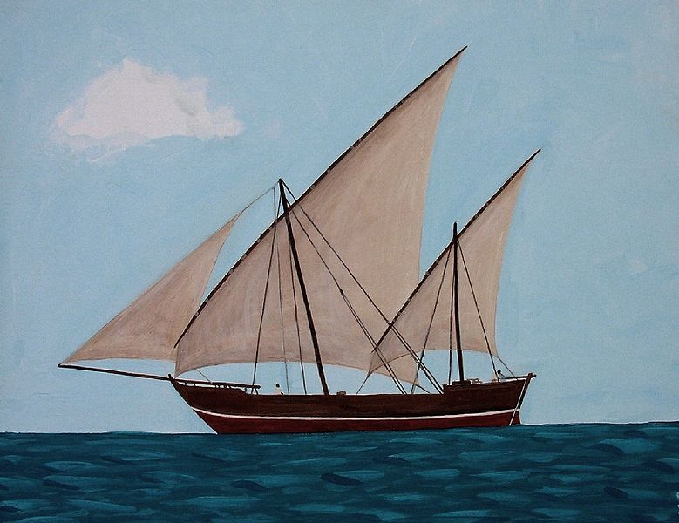
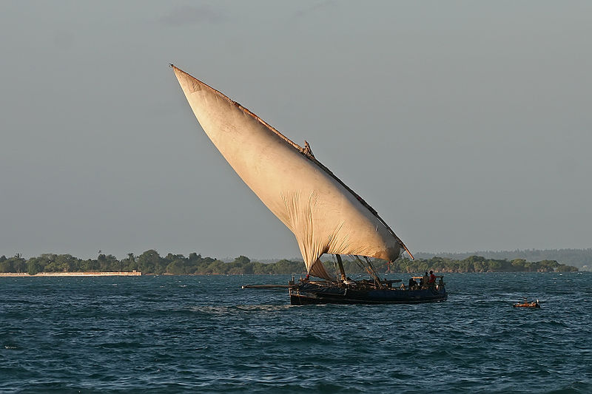
Dhow with lateen sails
The exact origins of the dhow are lost to history. Most scholars believe that it originated in China from 600 B.C. to 600 A.D.

Slide 38
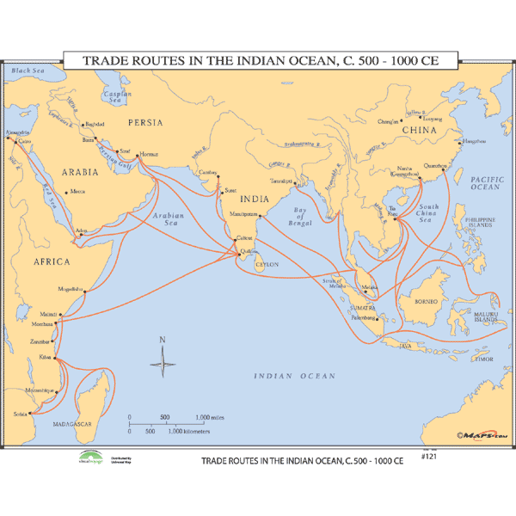

Slide 39
Products that Contributed to Indian Ocean Commerce
Mediterranean—ceramics, glassware, wine, gold, olive oil
East Africa—ivory, gold, iron goods, slaves, tortoiseshells, quartz, leopard skins
Arabia—frankincense (desired far beyond Indian Ocean world), myrrh, perfumes
India—grain, ivory, precious stones, cotton textiles, spices, timber
SE Asia—tin, sandlewood, cloves, nutmeg, mace
China—silks, porcelain, tea

Slide 40
The Sand Roads

Slide 41
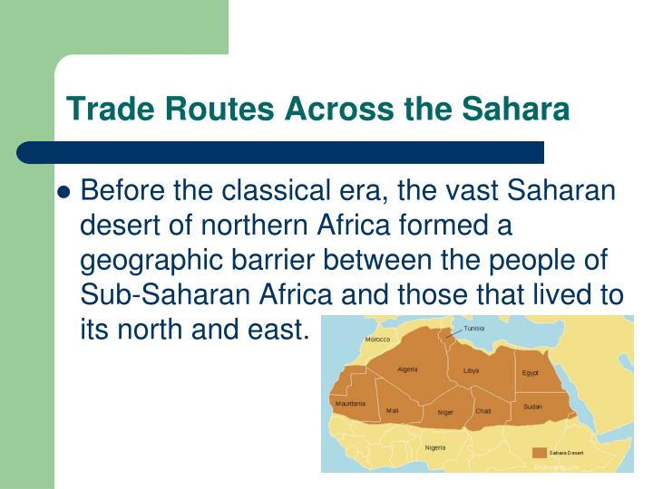

Slide 42
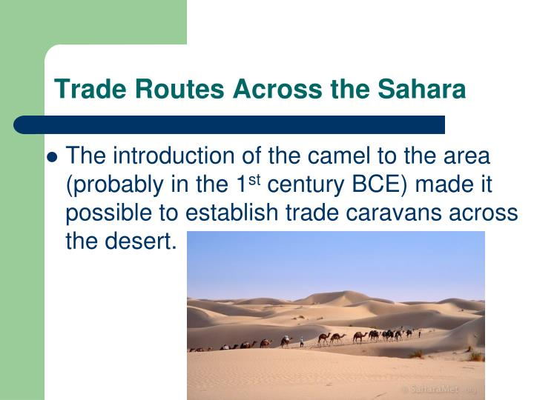

Slide 43
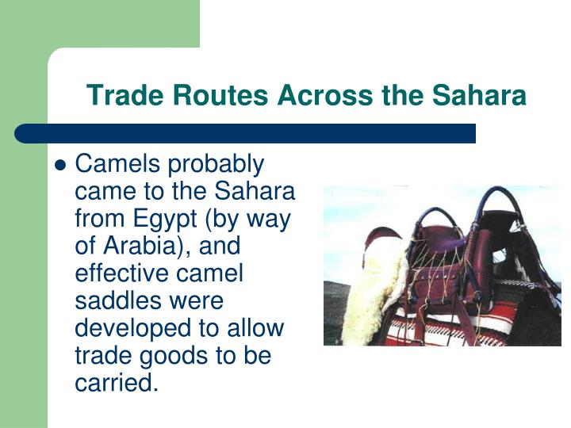

Slide 44
Exchange across the Sahara
Commercial Beginnings in West Africa:
  North had manufactured goods, salt, horses, cloth, dates
  South had crops, gold, ivory, kola nuts, slaves
Introduction of camel was crucial, early in CE
Regular trans-Saharan commerce by 300-400 CE
Huge caravans, up to 5000 camels
Eventually ed to a number of states in western and central Sudan: Ghana, Mali, Songhay, Kanem, and Hausaland.
Slaves came mostly from south, most sold in North Africa.

Slide 45
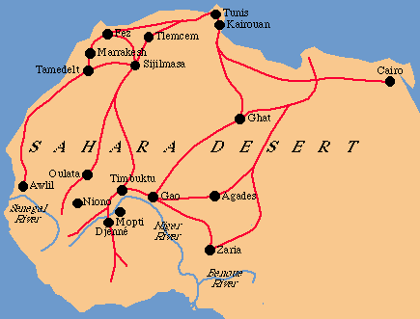

Slide 46
Important Goods Traded on the Sand Roads
West Africa provided ivory, kola nuts, slaves and gold
In return they received horses, cloth, dates, various manufactured goods, and salt

Slide 47
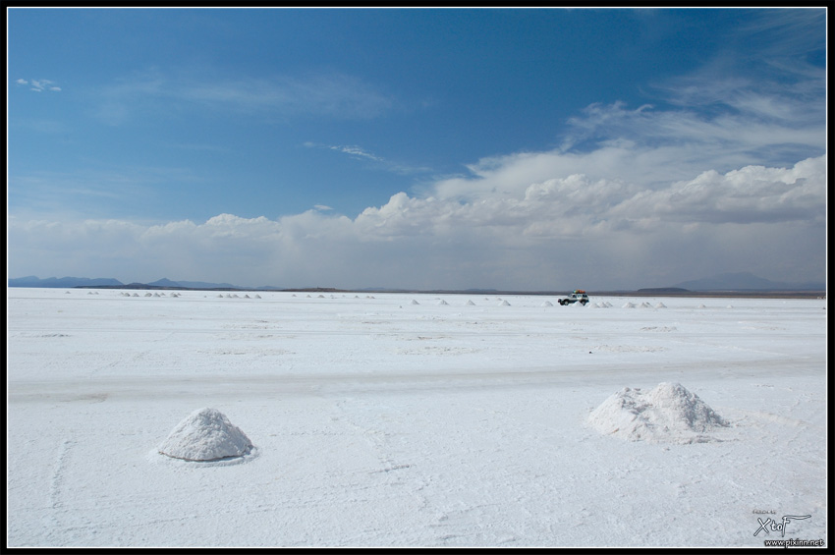

Slide 48
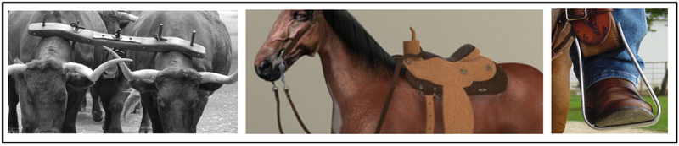
New Technologies Facilitated Long-Distance Exchange
Saddles and stirrups
Horses and especially camels (could go for 10 days without water)
Lateen sail and dhow ships
Yokes were also important to allow a pair of oxen to pull a load together

Slide 49
The Spread of Religion

Slide 50
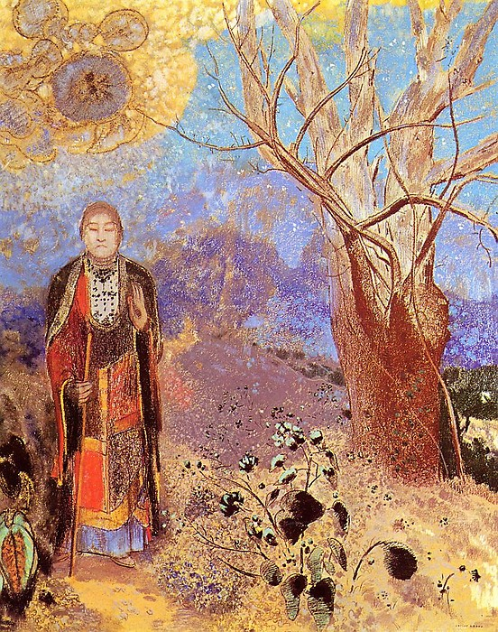
Buddhism in India
Siddhartha Gautama (Buddha) first announced his doctrine publicly in India in 528 B.C.
By the 3rd Century B.C., Buddhism was well-established in northern India
Buddhism was especially successful in attracting merchants as converts
The Buddha by Odilon Redon

Slide 51
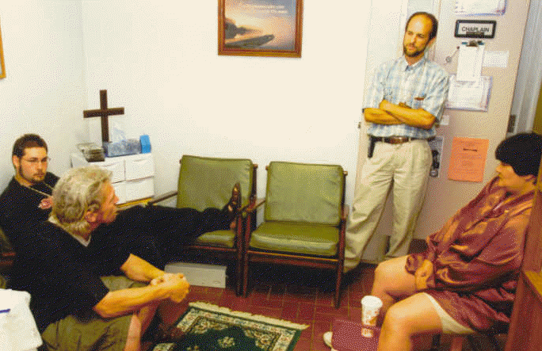
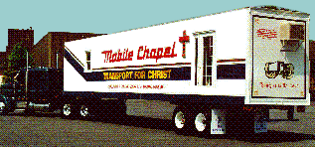
Spread of Buddhism
Merchants carried Buddhism along the Silk Roads where it first established a presence in the oasis towns where merchants and their caravans stopped for food, rest, lodging, and markets
Dunhuang was one such spot
In the same tradition, today there are a growing number of truck stop ministries

Slide 52
Spread of Buddhism
At Dunhuang, the Silk Road divides into two branches
  By the 4th Century A.D., a sizeable Buddhist community had emerged there

Slide 53
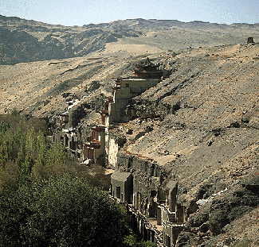
Buddhism at Dunhuang
  Between 600 and 1000 A.D., Buddhists built hundreds of cave temples around Dunhuang depicting scenes of Buddha
  Assembled libraries of religious literature
  Supported missionaries which spread Buddhism throughout China

Slide 54
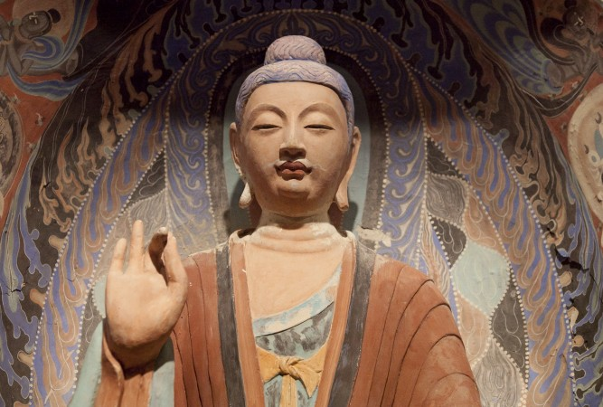
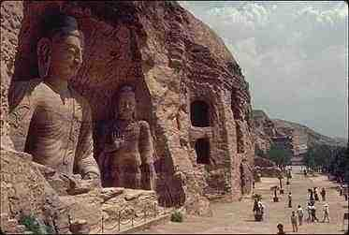
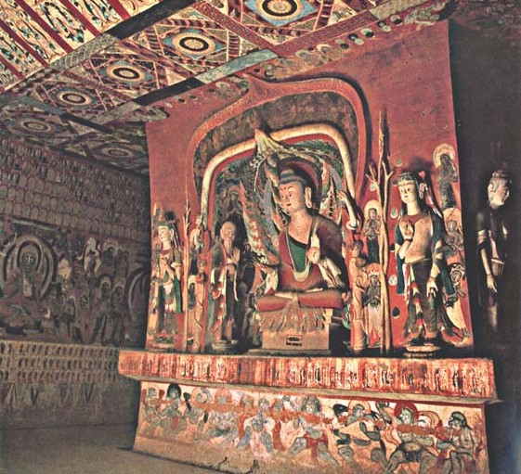
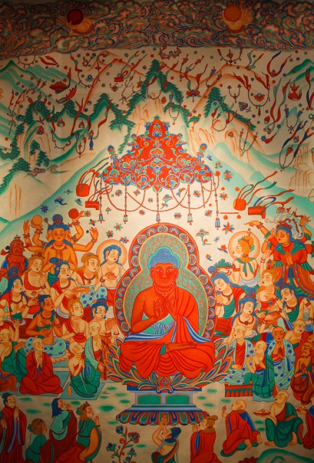
Dunhuang

Slide 55
Transformation of Buddhism
Monasteries established in the rich oasis towns became secular and wealthy
Mahayana Buddhism flourished on the silk roads
Theravada Buddhism was established in SE Asia by the missionaries sent out by Asoka
NW India, influenced by Alexander the Great, statues of the Buddha reveal Greek influences
Gods of many peoples along the Silk Roads were incorporated into Buddhist practice as bodhisattvas

Slide 56
Spread of Hinduism
Hinduism also spread along the Silk Roads, primarily along the sea lanes
  Indian merchants brought Brahmin priests
  This for example is how Hinduism spread from India to Malaya

Slide 57
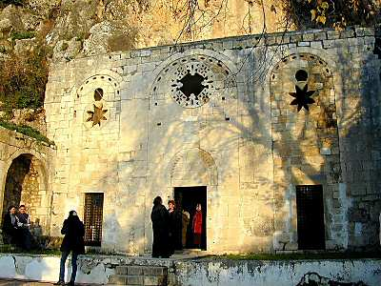
Spread of Christianity
Antioch, the western terminus of the overland Silk Roads, was an important center in early Christianity
  “Then Barnabas went to Tarsus to look for Saul, and when he found him, he brought him to Antioch. So for a whole year Barnabas and Saul met with the church and taught great numbers of people. The disciples were called Christians first at Antioch.” Acts 11: 25-26
St. Peter’s cave church in Antioch

Slide 58
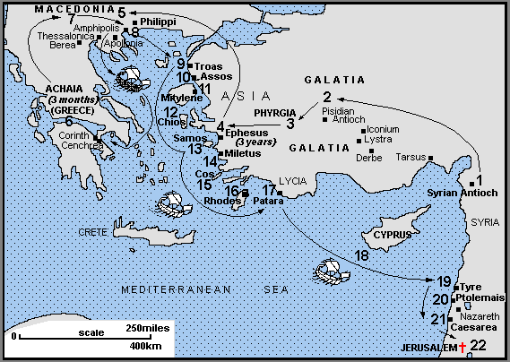
Spread of Christianity
Paul began his missionary journeys at Antioch

Slide 59
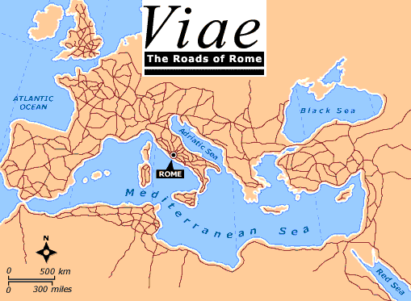
Spread of Christianity
Like other religions, Christianity followed the trade routes and expanded east throughout Mesopotamia, Iran, and as far away as India
However, its greatest concentration was in the Mediterranean basin, where the Roman Roads, like the Silk Roads, provided ready transportation

Slide 60
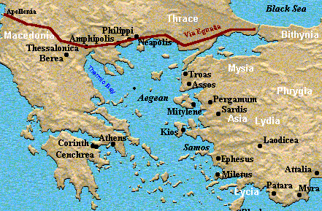
Spread of Christianity
A good example is Paul’s visit to Thessalonica (Acts 17: 1)
Thessalonica was the principle city and primary port of Macedonia (part of present day Greece)
It was located at the intersection of two major Roman roads, one leading from Italy eastward (Via Egnatia) and the other from the Danube to the Aegean

Slide 62
The Spread of Disease

Slide 63
Spread of Disease
Long-distance trading led to spread of disease
Most lethal junctures: when an unfamiliar disease arrives in a new culture
Athens, 430-429 BCE, infection from Egypt
The Antonine Plague (165-180 A. D.) was a plague of either smallpox or measles brought back to the Roman Empire by troops returning from campaigns in the Near East
  Roman emperor Marcus Aurelius Antoninus was among the victims
The disease broke out again nine years later and the Roman historian Dio Cassius reported it caused up to 2,000 deaths a day at Rome
Total deaths have been estimated at five million

Slide 64
Bubonic Plague
Between 534 and 750 CE. Intermittent outbreaks of the plague ravaged coastal areas of the Mediterranean Sea
Constantinople lost 10,000/day for 40 days in 534 CE.
Between 1346 and 1350 one third to one half of Europe died from the plague

Slide 65
Spread of Crops
Rice and cotton spread from South Asia to the Middle East, which led to changes in farming and irrigation techniques
  Example---the Qanat system

Slide 66
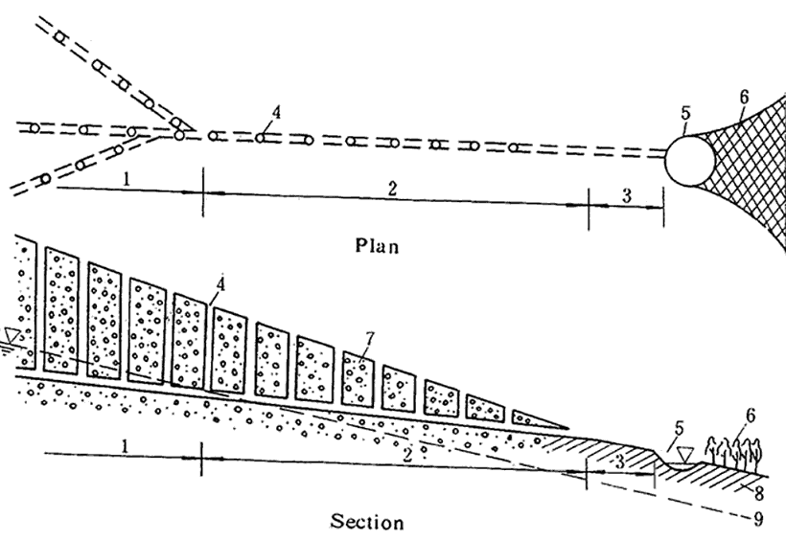
Qanat System
In the early part of the first millennium B.C., Persians started constructing elaborate tunnel systems called qanats for extracting groundwater in the dry mountain basins of present-day Iran. Qanat tunnels were hand-dug, just large enough to fit the person doing the digging. Along the length of a qanat, which can be several kilometers, vertical shafts were sunk at intervals of 20 to 30 meters to remove excavated material and to provide ventilation and access for repairs. The main qanat tunnel sloped gently down from pre-mountainous alluvial fans to an outlet at a village. From there, canals would distribute water to fields for irrigation. These amazing structures allowed Persian farmers to succeed despite long dry periods when there was no surface water to be had. Many qanats are still in use stretching from China on the east to Morocco on the west, and even to the Americas.

Slide 67
Change and Continuity
Changes
  Move from barter to coins as system of exchange
  Greater interaction between civilizations – direct links between Rome and China
  Cultural diffusion through trade – spread of religion, architecture, disease
  Decline in trade in Europe after fall of Rome
Continuities
  Dominance of India in trade
  The importance of the Silk Road and maritime trade routes
  Constantinople as western trade hub

